Slide 1
CHAPTER 12
Financial Planning & Forecasting Financial Statements

Slide 2
Topics in Chapter
Financial planning
Additional funds needed (AFN) equation
Forecasted financial statements
Sales forecasts
Operating input data
Financial policy issues
Changing ratios

Slide 3
Intrinsic Value: Financial Forecasting
Forecasting:
Operating
assumptions
Forecasting:
Financial policy
assumptions
Projected
income
statements
Projected
additional
financing
needed (AFN)
Projected
balance
sheets
Weighted average
cost of capital
(WACC)
Free cash flow
(FCF)
FCF₁
FCF₂
FCF∞
Value = + + ··· +
(1 + WACC)∞
(1 + WACC)¹
(1 + WACC)²
Notes:
For value box in Ch 4 time value FM13.

Slide 4
Elements of Strategic Plans
Mission statement
Corporate scope
Statement of corporate objectives
Corporate strategies
Operating plan
Financial plan

Slide 5
Financial Planning Process
Forecast:
Determine:
Forecast:

Slide 6
Financial Planning Process (Continued)
Establish:
a performance-based management compensation system rewarding employees for creating shareholder wealth.
Monitor:
operations after implementing plan to spot any deviations & take corrective actions.

Slide 7
Pro Forma Financial Statements
Three important uses:
Forecast:
Evaluate:
Set:

Slide 8
Steps in Financial Forecasting
Forecast:
Project:
Decide:
See effects of plan on ratios & stock price

Slide 9
Suppose:
@ New level of business in upcoming year, $5 million is needed to support new level of assets in upcoming yr.
@ New Sales level, $1 million is generated in NI which goes to RE
Need $5
-Have $1
=Ext fin. Req’d $4

Slide 10
Additional Funds Needed Process
Determine $ needed during given period
1st determining how much $ firm generates internally during same period
Then subtracting funds generated from funds needed to determine external financing requirements
Enough funds to support projected level of business??

Slide 11
Additional Funds Needed Steps
Sales Forecast => Income Statement
Forecast Balance Sheet
A = L + OE
Funding or Financing Mix
Look @ effects of raising addt’l $ in #3.

Slide 12
Income Statement Additional Funds Needed
Sales +
-Op Costs +
=NI + => RE + => OE +

Slide 13
Balance Sheet Additional Funds Needed
ASSETS
LIABS + Stockholders Equity
Cash Y
A/R Y
Inventory Y
S/T Invests N
=C/Assets Sum
Fixed Assets Depends
=Total Assets Sum
A/P Y
Accruals Y
S/T Debt N
C/Liabs sum
L/T Debt N
C. Stock N
R/E from I/S
Total L & OE sum

Slide 14
AFN - Problem 1 AP&P Co.
In current year, sales for American Pulp & Paper were $60 million. Forecasting next year, management believes sales will increase by 20%, with a continued profit margin expected of 5% & dividend payout ratio of 40%. No excess capacity exists. Given following balance sheet (in millions), what is additional funding needed in next year’s forecast?

Slide 15
AFN - Problem 1 AP&P Co. Actual
Cash $ 3.0
A/R 3.0
Inventory 5.0
C/Assets $ 11.0
Fixed Assets 3.0
Total Assets $ 14.0

Slide 16
AFN - Problem 1 AP&P Co. Actual
A/P $ 2.0
Notes Payable 1.5
C/Liabs $ 3.5
L/T Debt 3.0
Common Equity 7.5
Total Liabs & Cmn Equity$ 14.0

Slide 17
AFN - Problem 1 AP&P Co. Actual
Sales $ 60.0
X profit margin ratio x.05
Profit (NI) $ =3.0
-Div Payout(40%) - 1.2
=Addts to RE =1.8

Slide 18
AFN - Problem 1 AP&P Co. Actual & Projected
I/S Orig(1+g) = Proj
Sales $ 60.0
X profit margin ratios x.05
Profit (NI) $ =3.0
-Div Payout(40%) - 1.2
=Addts to RE =1.8 =2.16

Slide 19
AFN - Problem 1 AP&P Co. Actual & Projected
B/S Orig(1+g)=Proj
Cash $ 3.0 (1.2) =
A/R 3.0
Inventory 5.0
C/Assets $ 11.0
Fixed Assets 3.0
Total Assets $ 14.0 =16.8
Need $16.8 of assets to be financed

Slide 20
AFN - Problem 1 AP&P Co. Actual & Projected
B/S Orig(1+g)=Proj
A/P $ 2.0
Notes Payable 1.5
C/Liabs $3.5
L/T Debt 3.0
Common Equity 7.5+
Total Liabs & Cmn Equity $ 14.0 =
Have Funds of $16.56

Slide 21
AFN - Problem 1 AP&P Co: AFN from Projected
Need Have Funds
$
= AFN =

Slide 22
Financing Feedbacks – 2nd pass
Financing feedbacks occur when additional financing costs of new external capital are included in analysis.
22

Slide 23
Financing Feedbacks-Circularity
When financing costs (additional interest expenses) are included:
NI falls, reducing addition to RE.
RE on balance sheet fall.
Balance sheet no longer balances.
More financing is needed.
Process repeats.

Slide 24
Financing Feedbacks-Solutions
Repeat process, iterate until balance sheet balances.
Manually
Using Excel’ Iteration feature.
Use Excel Goal Seek to find right amount of AFN.

Slide 25
AFN Equation
AFN =(A₀*/S₀)∆S −(L₀*/S₀)∆S −M(S₁)(1−DPOR)

Slide 26
Definitions of Variables in AFN
A₀*/S₀: Assets required to support sales: called capital intensity ratio.
ΔS: Increase in sales.
L₀*/S₀: Spontaneous liabilities ratio.
M: Profit margin (Net income/Sales)
DPOR: Div Payout ratio (Dividends/Net income)

Slide 27
AFN Equation & Prob 1 AP&P Co.
AFN =(A₀*/S₀)∆S −(L₀*/S₀)∆S −M(S₁)(1−DPOR)

Slide 28
Key Factors in AFN
Sales growth (g): higher g:
Capital intensity ratio (A₀*/S₀): higher capital intensity ratio
(more capital intensive):
Spontaneous-liabilities-to-sales ratio (L₀*/S₀): higher firm’s spontaneous liabilities:

Slide 29
AFN Key Factors (Continued)
Profit margin (Net income/Sales):
higher profit margin:
Payout ratio (DPS/EPS):
lower payout ratio:

Slide 30
AFN Some Preliminary Assumptions
Cost increase at same rate of sales
Assets increase “ “ “ “
Spontaneously generated funds increase at same rate of sales
Dividend Payout Ratio Constant

Slide 31
AFN % Sales Method
Most B/S accounts tied directly to sales.
Current level of total assets optimal for current sales level.

Slide 32
AFN ISSUES
Excess Capacity
Base-stock of inventory
Economies of Scale
Lumpy Assets.
Negative AFN

Slide 33
Possible Ratio Relationships: Constant A*/S Ratios
Inventories
400
300
200
A*/S
= 200/400
= 50%
100
A*/S
= 100/200
= 50%
Sales
0
200
400

Slide 34
Economies of Scale in A*/S Ratios
Inventories
400
300
A*/S
= 400/400
= 100%
A*/S
= 300/200
= 150%
Base
Stock
Sales
0
200
400

Slide 35
Nonlinear A*/S Ratios
Inventories
424
300
Sales
0
200
400

Slide 36
Possible Ratio Relationships: Lumpy Increments
Net plant
Capacity
Excess Capacity
(Temporary)
0
Sales

Slide 37
AFN & Capacity Issues
If PP&E @ 75% capacity,
& actual sales = $2,000
What’s sales level when @ full capacity?
(Full capacity sales)(% of capacity operating at) =
Actual Sales Level
so:
And
Full capacity sales = $2,667.

Slide 38
FINANCIAL FORECASTING & PLANNING affected by:
Economic activity
Market Share
Past data / trends
New business
Production Capabilities
Competitors Market Share
New products by both competitors & self
Pricing

Slide 39
FINANCIAL FORECASTING & PLANNING affected by:
Plant Capacities
Inflation
Advertising & Marketing
Promotions
Discounts
Sales & credit terms

Slide 40
Another Example Follows

Slide 41
Prob #2 Current Year Balance Sheet
Cash & sec. | $20 | Accts. pay. &
 |  | accruals | $100
Accounts rec. | 240 | Notes payable | 100
Inventories | 240 | Total CL | $200
Total CA | $500 | L-T debt | 100
 |  | Common stk | 500
Net fixed |  | Retained
Assets | 500 | Earnings | 200
Total assets | $1000 | Total claims | $1000

Slide 42
Prob #2 Current Yr Income Statement
Sales | $2,000.00
Less: COGS (60%) | 1,200.00
SGA costs | 700.00
EBIT | $100.00
Interest | 16.00
EBT | $84.00
Taxes (40%) | 33.60
Net income | $50.40
Dividends (30%) | $15.12
Add’n to RE | 35.28

Slide 43
Key Ratios
 | NWC | Industry | Condition
BEP | 10.00% | 20.00% | Poor
Profit Margin | 2.52% | 4.00% | Poor
ROE | 7.20% | 15.60% | Poor
DSO | 43.20 days | 32.00 days | Poor
Inv. turnover | 8.33x | 11.00x | Poor
F.A. turnover | 4.00x | 5.00x | Poor
T.A. turnover | 2.00x | 2.50x | Poor
Debt/assets | 30.00% | 36.00% | Good
TIE | 6.25x | 9.40x | Poor
Current ratio | 2.50x | 3.00x | Poor
Payout ratio | 30.00% | 30.00% | O.K.

Slide 44
Key Ratios (Continued)
 | NWC | Ind. | Cond.
Net oper. prof. margin after taxes | 3.00% | 5.00% | Poor
(NOPAT/Sales)
Oper. capital requirement | 45.00% | 35.00% | Poor
(Net oper. capital/Sales)
Return on invested capital | 6.67% | 14.00% | Poor
(NOPAT/Net oper. capital)

Slide 45
AFN (Additional Funds Needed): Key Assumptions
Operating at full capacity in Current Yr.
Each type of asset grows proportionally with sales.
Payables & accruals grow proportionally with sales.
Current Yr. profit margin (2.52%) & payout (30%) will be maintained.
Sales are expected to increase by $500 million. (%ΔS = 25%)

Slide 46
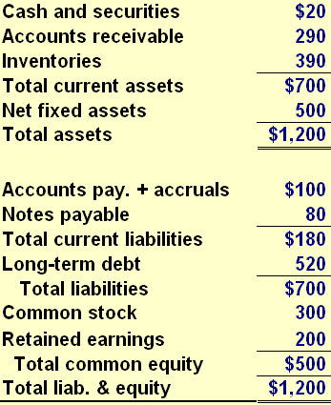
Prob # 3 Balance Sheet, Hatfield, Current Yr.
46

Slide 47
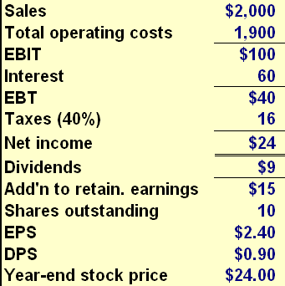
Income Statement, Hatfield, Current Year
47

Slide 48
Comparison of Hatfield to Industry Using DuPont Equation
ROE = NI/S × S/TA × TA/E
NI/S = $24/$2,000 = 1.2%
S/TA = $2,000/$1,200 = 1.67
TA/E = $1,200/$500 = 2.4
ROE_{Hatfield} = 1.2% × 1.67 × 2.4 = 4.8%.
ROE_{Industry} = 2.74% × 2.0 × 2.13 = 11.6%.

Slide 49
Comparison (Continued)
Profitability ratios lower because of higher interest expense.
Lower asset management ratios due to high levels of receivables & inventory.
Higher leverage than industry.

Slide 50
AFN (Additional Funds Needed) Equation: Key Assumptions
Operating at full capacity in Current Yr.
Sales are expected to increase by 15% ($300 million).
Asset-to-sales ratios remain same.
Spontaneous-liabilities-to-sales ratio remains same.
Current Yr profit margin ($24/$2,000 = 1.2%) & payout ratio (35%) will be maintained.

Slide 51
Hatfield’s AFN Using AFN Equation
AFN = (A₀*/S₀)∆S −(L₀*/S₀)∆S −M(S₁)(1−POR)
AFN = ($1,200/$2,000)($300)
− ($100/$2,000)($300)
− 0.012($2,300)(1 - 0.375)
AFN = $180 − $15 − $17.25
AFN = $147.75 million.

Slide 52
Self-Supporting Growth Rate
Self-Supporting growth rate is maximum growth rate firm could achieve if it had no access to external capital.
M(1 − POR)S₀
A₀* − L₀* − M(1 − POR)S₀
Self-supporting g = ______________________________
(0.012)(1−0.35)($2,000)
$1,200 − $100 − (.012)(1−0.35)($2,000)
g = ______________________________________________
$15.60
$1,084
g = ____________ = 1.44%
52

Slide 53
Self-Supporting Growth Rate
If Hatfield’s sales grow less than 1.44%, firm will not need any external capital.
firm’s self-supporting growth rate is influenced by firm’s capital intensity ratio. more assets firm requires to achieve a certain sales level, lower its sustainable growth rate will be.

Slide 54
Forecasted Financial Statements: Initial Assumptions for “Steady” Scenario
Operating ratios remain unchanged.
No additional notes payable, LT bonds, or common stock will be issued.
interest rate on all debt is 10%.
If additional financing is needed, then it will be raised through a line of credit. line of credit will be tapped on last day of year, so there will be no additional interest expenses due to line of credit.
Interest expenses for notes payable & LT bonds are based on average balances during year.
If surplus funds are available, surplus will be paid out as a special dividend payment.
Regular dividends will grow by 15%.
Sales will grow by 15%.

Slide 55
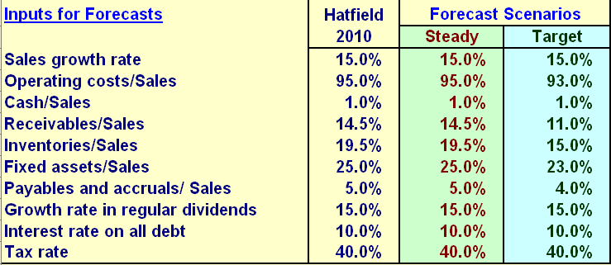
Inputs for Steady Scenario & Target Scenario
55

Slide 56
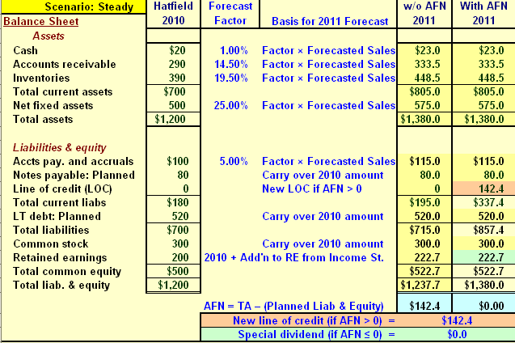
Forecasted Financial Statements: Balance Sheets for Steady Scenario
56

Slide 57
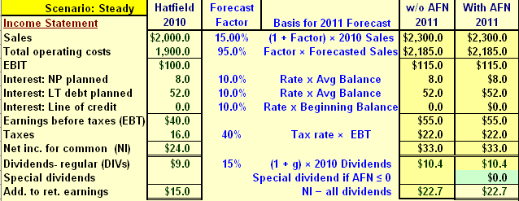
Forecasted Financial Statements: Income Statement for Steady Scenario

Slide 58
Additional Financing Needed
AFN = $142.4.
This AFN amount ≠ AFN equation amount.
difference results because profit margin doesn’t remain constant.

Slide 59

Forecasted Financial Statements, Target Ratios

Slide 60
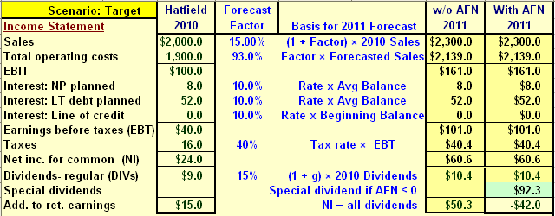
Forecasted Financial Statements, Target Ratios

Slide 61
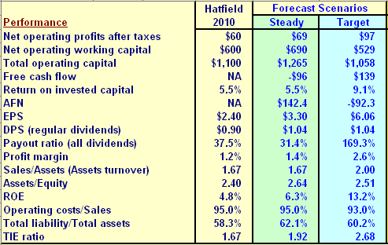
Performance Measures

Slide 62
Compensation & Forecasting
Forecasting models can be used to set targets for compensation plans.
key is to rewards employees for creating shareholder intrinsic shareholder value.
emphasis should be on long run rather than short-run performance.

Slide 63
Financing Feedbacks
Forecast does not include additional interest from line of credit because we assumed that line was tapped only on last day of year.
It would be more realistic to assume that line is drawn upon throughout year.
Financing feedbacks occur when additional financing costs of new external capital are included in analysis.
63

Slide 64
Financing Feedbacks-Circularity
When financing costs are included, NI falls, reducing addition to RE.
RE on balance sheet fall.
Balance sheet no longer balances.
More financing is needed.
Process repeats.

Slide 65
Financing Feedbacks-Solutions
Repeat process, iterate until balance sheet balances.
Manually
Using Excel’ Iteration feature.
Use Excel Goal Seek to find right amount of AFN.
Use simple formula to adjust AFN so that adjusted amount of financing incorporates financing feedback; see Tab 2 in Ch12 Mini Case.xls.

Slide 66
Multi-Year Forecasts: Buildup in Line of Credit
If annual projections show continuing increase in LOC’s balance, board of directors would have to step in & make decisions regarding capital structure or dividend policy:
Issue LT Debt
Issue Equity
Cut dividends

Slide 67
Multi-Year Forecasts: Special Dividends
board of directors might decide to do something else with surplus instead of pay special dividends.
Buy back shares of stock.
Purchase short-term securities.
Pay down debt.
Make an acquisition.
67

Slide 68
Modifying Forecasting Model
Can maintain target capital structure each year by modifying model to issue/retire LT debt or issue/repurchase shares of stock.

